Slide 1
Historical Traffic Crash Data in Relation to the Adoption of Mobile Phones

Slide 2
Questions
How has the adoption of mobile and smart phones into everyday life affected the incidence of traffic accidents in the following states?
How has the adoption of mobile applications into everyday life affected the incidence of traffic accidents in these states?
Have any traffic laws put in place after the common adoption of mobile/smart phones helped to curb accident frequency?
Does age play a factor in distracted driving accidents?

Slide 3
Hypothesis:
U.S. automobile accidents have increased significantly with the adoption of smartphones.

Slide 4
Data, Exploration, and Cleanup
Data:
Exploration:
Cleanup:
Merging, remove empty cells, convert to float

Slide 5
Data Sources:
Accident data
FARS and NHTSA (https://www.nhtsa.gov/)
CSV downloads (Excel) and API (Pandas)
Registered Drivers by State
CSV download (Pandas)
Google Public Data
Mobile Adoption Data
Mobile App adoption, Mobile phone and smartphone adoption,
Pew Research, Statisa

Slide 6
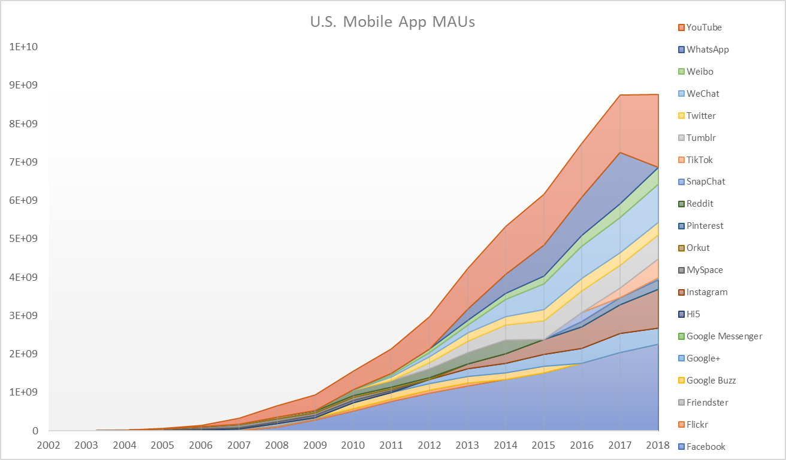
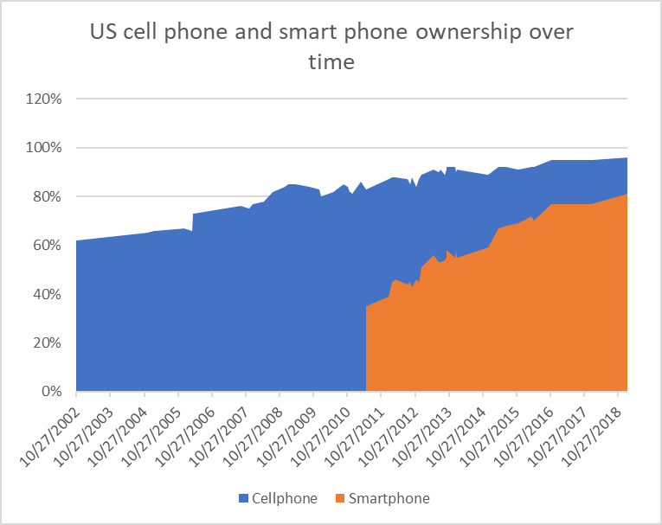
Data Visualization

Slide 7
Acknowledgment of Limitations

Slide 8
Summary

